Slide 1

Managing and publishing data
Jonathan Rans
Digital Curation Centre, Edinburgh
J.Rans@ed.ac.uk
Twitter: @JNRans
Introduction to Open Science and developing RDM services, Riga, Latvia

Slide 2
What will we cover?
Introduction and definitions
How to manage data
What to publish and where to put it

Slide 3

Definitions

Slide 4
Definition of research data
Pilot focuses on research data specifically
  ‘Research data’ refers to information, in particular facts or numbers, collected to be examined and considered as a basis for reasoning, discussion or calculation.
  In a research context, examples of data include statistics, results of experiments, measurements, observations resulting from fieldwork, survey results, interview recordings and images. The focus is on research data that is available in digital form.
Guidelines on Open Access to Scientific Publications and Research Data in Horizon 2020 v.2.1, 15 February 2016, p3

Slide 5
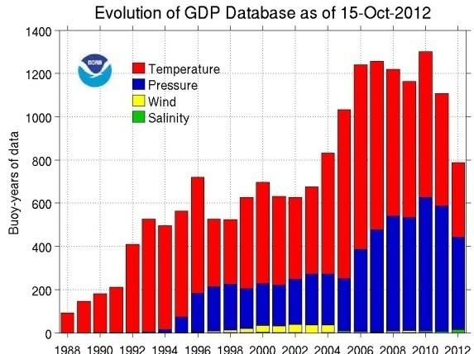

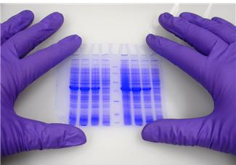



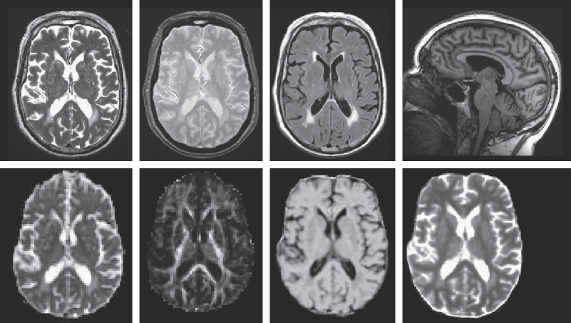
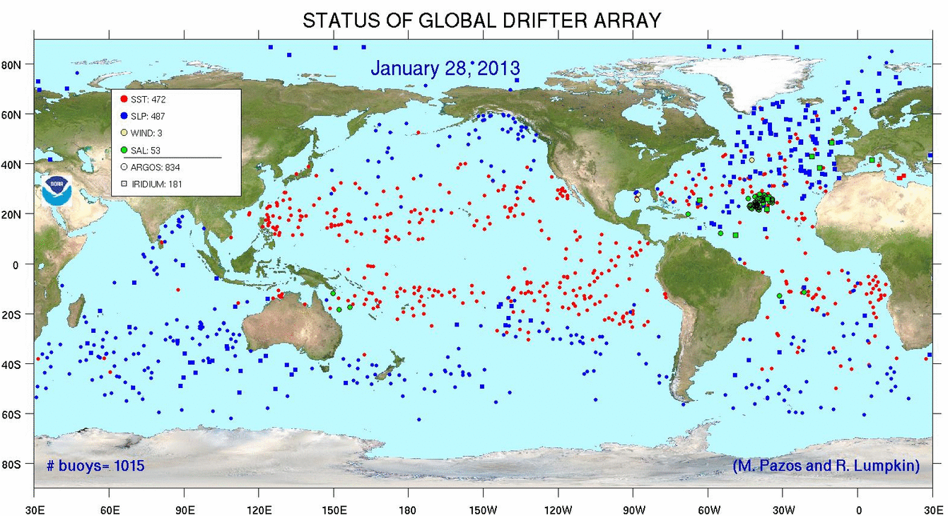
So, what might this include?
http://www.aoml.noaa.gov/phod/dac/array_growth.html
http://www.sbirc.ed.ac.uk/documents/lbc_protocol.pdf
http://www.aoml.noaa.gov/phod/graphics/dacdata/globpop.gif
Notes:
Instrument measurements
Experimental observations
Still images, video and audio
Text documents, spreadsheets, databases
Quantitative data (e.g. survey data)
Survey results & interview transcripts
Simulation data, models & software
Slides, artefacts, specimens, samples
Questionnaires
Sketches, diaries, lab notebooks …

Slide 6
What is research data management?
Plan
Create
Use
Appraise
Deposit and Publish
Discover and Reuse
“an explicit process covering the creation and stewardship of research materials to enable their use for as long as they retain value.”
Data management is part of
good research practice
Notes:
6

Slide 7
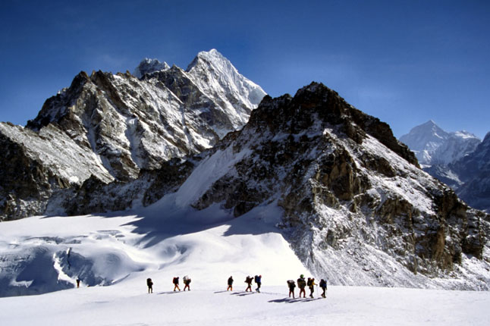
How to manage and share data

Slide 8
The Research Data Lifecycle
Data Management Planning
Data creation
Annotating / documenting data
Analysis, use, versioning
Storage and backup
Publishing papers and data
Preparing for deposit
Archiving and sharing
Licensing
Citing…
Plan
Create
Use
Appraise
Deposit and Publish
Discover and Reuse
Notes:
Note that we’ll pick up on documentation, licensing and publishing

Slide 9

What is metadata?
Data about data
Citation
Discovery
Reuse
Notes:
Documentation and metadata are essentially descriptive information about the information contained in a dataset. There should be good documentation at the study level, for example a description of the research methodology that created the data – [the best metadata the data can have is the publication it supports] or a data paper. There should also be documentation at the file, item and variable level suitable so that someone reusing the data can understand it – this could be ensuring that excel spreadsheets have sensible row and column descriptions or that a document is included with the dataset which properly explains any abbreviations used.

Slide 10
What is the difference?
Metadata
  Standardised
  Structured
  Machine and human readable
Documentation
Metadata
Notes:
Metadata is a subset of documentation
Documentation is a catch-all term which can include some very high-level, human-readable, loosely structured information about the dataset – for example a description of the laboratory method used to generate a set of results or a sketch book accompanying a work of sculpture. The term metadata has come to define a subset of documentation information that uses standardised terms and is presented in a structured way. This metadata will be in a form enabling it to be read by machines and/or may be presented in human readable form as well.

Slide 11

What is the minimum required?
DataCite metadata used by OpenAIRE
Citation/disambiguation
  Identifier e.g. DOI
  Creator
  Title
  Publisher
  Publication Year
Licencing/access conditions
Notes:
Potentially, the bare minimum of metadata required will be defined by the repository that accepts the dataset. This could correspond to the DataCite mandatory minimum metadata set although it is very likely that other elements will be required, whether by the repository or by the research funder. This metadata set is designed for citation and disambiguation, in other words ensuring that the dataset a researcher is reusing is identical to one cited in a journal article or online. This set of metadata does little to make the resource visible to researchers speculatively searching for relevant data to reuse.

Slide 12




What are persistent identifiers?
They are an alphanumeric code identifying a resource, organisation or individual
They must be
  Unique
  Persistent
Ideally they should be actionable too

Slide 13
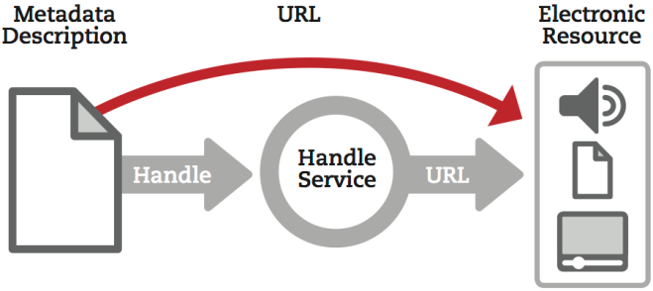
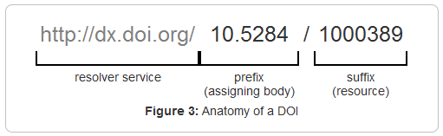
How do persistent identifiers work
Taken from the DCC guide: How to Cite Datasets and Link to Publications
http://www.dcc.ac.uk/resources/how-guides/cite-datasets
Notes:
The likely home of an electronic research data resource attached to a persistent identifier is a data repository (exceptions being resources not available over the web which have a PI attached to a metadata record – physical resource, cumbersomely large dataset etc.)

Slide 14
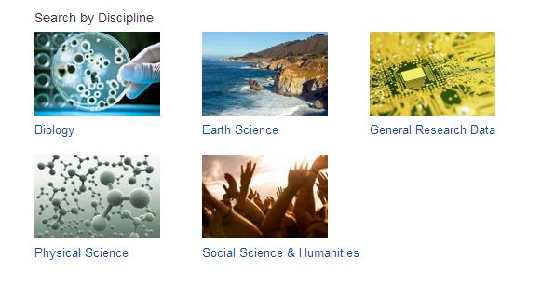

Disciplinary metadata standards to use
Use relevant standards for interoperability
www.dcc.ac.uk/resources/metadata-standards
Notes:
To make sure their data can be understood by themselves, their community and others, researchers should create metadata and documentation.
Metadata is basic descriptive information to help identify and understand the structure of the data e.g. title, author...
Documentation provides the wider context. It’s useful to share the methodology / workflow, software and any information needed to understand the data e.g. explanation of abbreviations or acronyms
There are lots of standards that can be used. The DCC started a catalogue of disciplinary metadata standards which is now being taken forward as an international initiative via an RDA working group
14

Slide 15
Some formats are better for long-term
It’s preferable to opt for formats that are:
Uncompressed
Non-proprietary
Open, documented
Standard representation (ASCII, Unicode)
Data centres may have preferred formats for deposit e.g.
Type | Recommended | Non-preferred
Tabular data | CSV, TSV, SPSS portable | Excel
Text | Plain text, HTML, RTF PDF/A only if layout matters | Word
Media | Container: MP4, Ogg Codec: Theora, Dirac, FLAC | Quicktime H264
Images | TIFF, JPEG2000, PNG | GIF, JPG
Structured data | XML, RDF | RDBMS
Further examples: http://www.data-archive.ac.uk/create-manage/format/formats-table
Notes:
Some formats are better for data sharing and long-term preservation than others.
It’s preferable to use formats that are uncompressed (e.g. large, high-quality files like .wav), non-proprietary (i.e. open) standards that are documented and well-understood. This aids preservation and interoperability.
Some data centres have preferred formats for deposit so it’s worthwhile encouraging researchers to consult these to check.

Slide 16
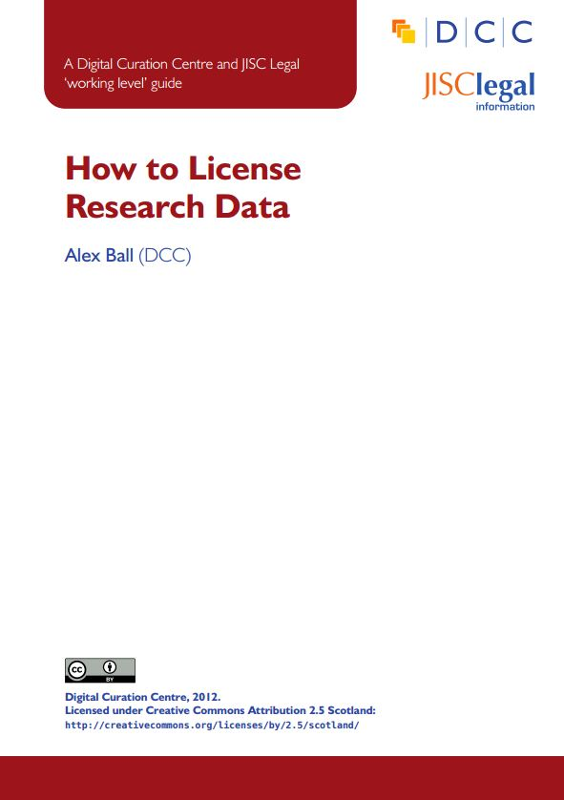




Licensing research data openly
This DCC guide outlines the pros and cons of each approach and gives practical advice on how to implement your licence
CREATIVE COMMONS LIMITATIONS
NC Non-Commercial
What counts as commercial?
ND No Derivatives
Severely restricts use
These clauses are not open licenses
Horizon 2020 Open Access guidelines point to:
or
www.dcc.ac.uk/resources/how-guides/license-research-data
Notes:
Guidance from the DCC can also help researchers to understand data licensing. This guide outlines the pros and cons of each approach e.g. the limitations of some CC options
The OA guidelines under Horizon 2020 point to CC-0 or CC-BY as a straightforward and effective way to make it possible for others to mine, exploit and reproduce the data. See p11 at: http://ec.europa.eu/research/participants/data/ref/h2020/grants_manual/hi/oa_pilot/h2020-hi-oa-pilot-guide_en.pdf
16

Slide 17


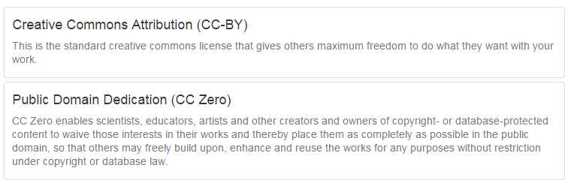
EUDAT licensing tool
Answer questions to determine which licence(s) are appropriate to use
http://ufal.github.io/lindat-license-selector

Slide 18

Options for closed data
Institutional data archive/vault
Safe havens – (e.g. secure patient data)
3rd party data archiving
Cloud storage
Institutional servers – the ‘do nothing’ option

Slide 19

Options for open data
Domain repository
General repository – Figshare, Zenodo, Dryad
Institutional repository
Journal supplementary material
Departmental web page
Notes:
Domain best
General – need to ensure it’s suitable for your use
Institutional – will keep data of low value or data with no other home but may not ensure targeted visibility
Journal – fulfils journal requirements but does not offer repo functionality or longevity required by funders
Web page – may target domain academics and allow manipulation of data and support for living datasets. Does not have citability, longevity or engender user trust that the resource is the same as the one described in publications.

Slide 20
Finding external repositories
Go
General directories
  Re3data.org
Domain specific directories
  e.g. life sciences – Biosharing.org
Data journal recommendations
  Edinburgh research data blog: Sources of dataset peer review
Funding body recommendations
  E.g. Wellcome Trust Data repositories and database sources
Notes:
Data journals require that the data being described in articles be freely available and usually mandate where it should be deposited, this can help to identify community-accepted repositories.
Some journals may also offer recommendations for appropriate places to deposit research data

Slide 21

A conversation with the researcher
There may be an accepted repository used by peers or required by funders
Multidisciplinary studies may not have an obvious home
Data types and volumes will impact on decision

Slide 22
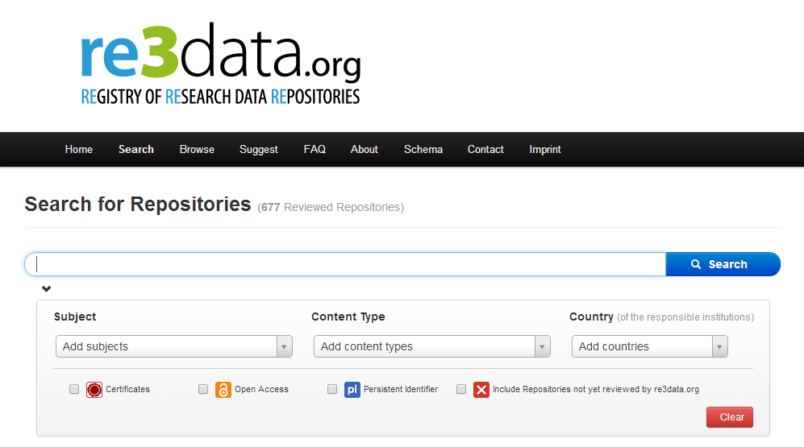
Data repositories
Does your publisher or funder suggest a repository?
Are there data centres or community databases for your discipline?
Does your university offer support for long-term preservation?
Zenodo
OpenAIRE-CERN joint effort
Multidisciplinary repository
Multiple data types
    Publications
    Long tail of research data
Citable data (DOI)
Links funding, publications, data & software
www.zenodo.org
http://databib.org
http://service.re3data.org/search
Notes:
22

Slide 23


Any Questions?
Jonathan Rans
J.Rans@ed.ac.uk
@JNRans
Image Credits
Research Dictionary: http://www.saquiresearch.com
Himalayas: www.cntraveller.com

